Slide 1

Porter’s Five Forces Model
Principles of Management

Slide 2
Overview→

Slide 3
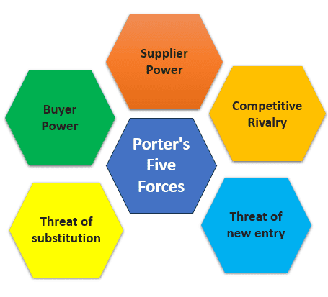
Definition
Porter's Five Forces is a strategic analysis model used to study a market or industry and determine its competitiveness.
Developed by Harvard business professor Michael Porter in 1978.
A model that identifies and analyzes five competitive forces that shape every industry and helps determine an industry's strengths and weaknesses.

Slide 4
The Five Forces Framework→

Slide 5

Competitive Rivalry
Refers to the competition from other players within the industry.
The number of competitors
Industry growth
Similarities in products/services offered
Exit barriers
Fixed costs

Slide 6

Potential for New Entrants in The Industry
A market which is easier to enter may result in each player having a smaller market share.
Economies of scale
Product differentiation
Capital cost
Distribution channels
Regulations
Switching costs

Slide 7
Bargaining Power of Suppliers
Factors by which the power of suppliers in an industry can be gauged are as follows:
Number of suppliers - When a few firms can give a company something it needs to stay in business; each has greater negotiating power.
Uniqueness – if a supplier provides a unique product, it is more dominant.
Switching costs
Forward integration

Slide 8

Bargaining Power of the Buyer
Number of buyers – a fewer number of buyers implies more power.
Purchase size – a larger purchase size may allow the buyer to negotiate more.
Switching costs – in industries like telecommunications, it is easier for customers to switch providers.
Price sensitivity
Informed buyers

Slide 9
Threat of New Substitutes
When customers can find substitutes for a sector's services, that is a major threat to the companies in that industry.
Some ways that this threat can be magnified are -
Relative price performance
Willingness to go elsewhere
The sense that products are similar
Availability of close substitutes

Slide 10
Significance →

Slide 11
Quote
Should a company invest in a hydrogen-based green steel manufacturing facility in India?

Slide 12
Application of Porter’s Framework
Framework | Remark
Competitive Rivalry | Rivalry is high, but differentiation through “green steel” certification may create temporary advantage.
Potential for New Entrants | Entry barriers are very high, which protects established integrated steel producers.
Power of Suppliers | Supplier power is high until domestic hydrogen production scales up and costs decline.
Power of Buyers | Buyer power is moderate, but regulation driven demand may reduce price sensitivity for green steel exports.
Threat of Substitutes | Substitute threat high.

Slide 13
Thank you

